Slide 1
Face Mask Detection

Slide 2
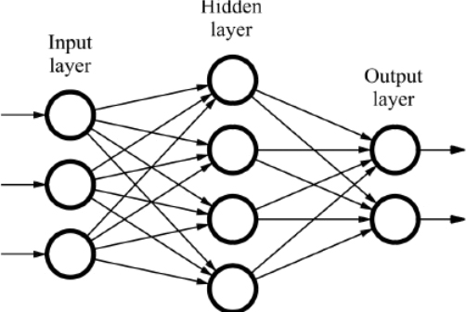
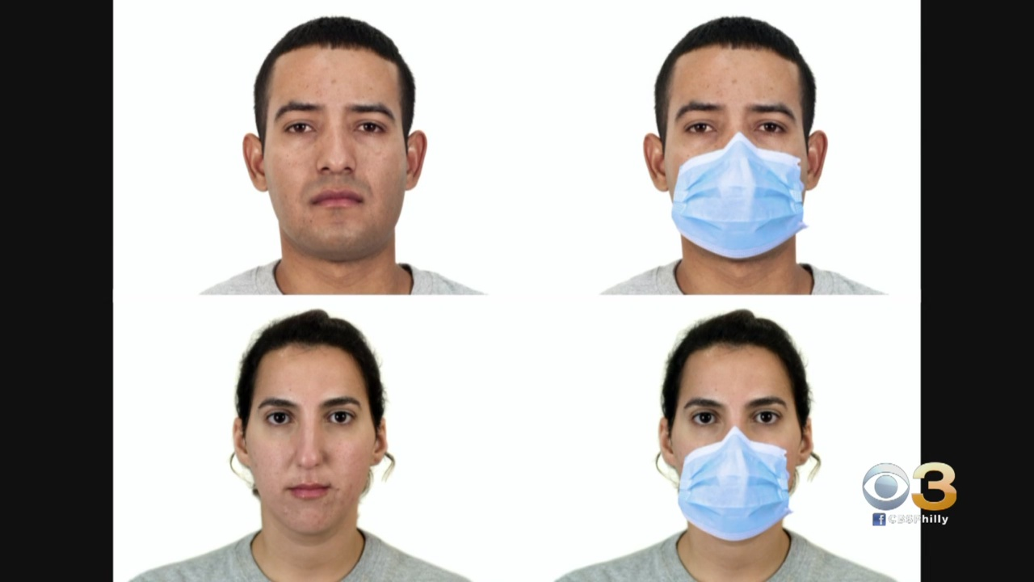
Baseline step
0 – No Mask
1 – With Mask
Detecting whether a mask exists for one person in an image.

Slide 3
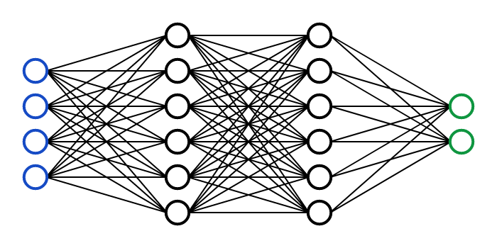
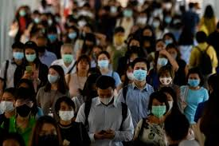
Second step
0 – No Mask
1 – With Mask
Detecting whether a mask exists for more than one person in an image.

Slide 4
Third step
0 – No Mask
1 – With Mask
Real-Time Detection for more than one person in a video/stream.

Slide 5
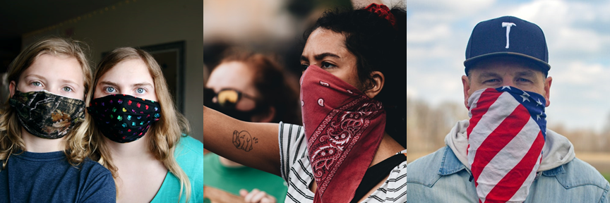
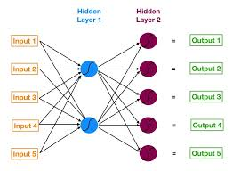
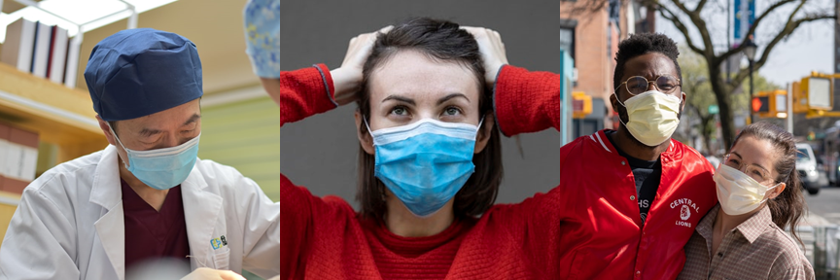
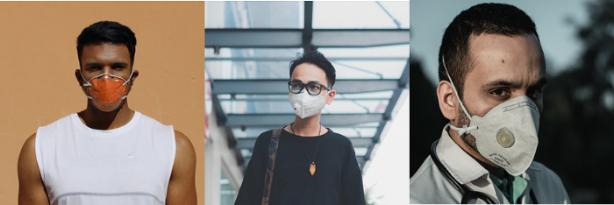
Additional step
Detecting the type of a mask.
Detection in real-time.
0 – No Mask
1 – Homemade
2 – Surgical
3 – N95
4- P100

